Slide 1
Enhanced & Sustained Care
Dom Care Q&A
Catherine Knighton
Faith Lowe

Slide 2
The challenge
Increasing demand: An ageing population and increasing number of adults with complex conditions and chronic illnesses​
Too few care workers; Hampshire need an extra 6000 people by 2025, if we don’t innovate​ (estimate pre covid)
A survey of Care England members revealed over 95% of members stating that they are finding it difficult to recruit staff.
Pandemic has accelerated technology adoption….…But also exposed the physical and emotional demands of care delivery
We asked ourselves how can we ensure both good service user experience and rewarding jobs for care staff? Can technology help?

Slide 3
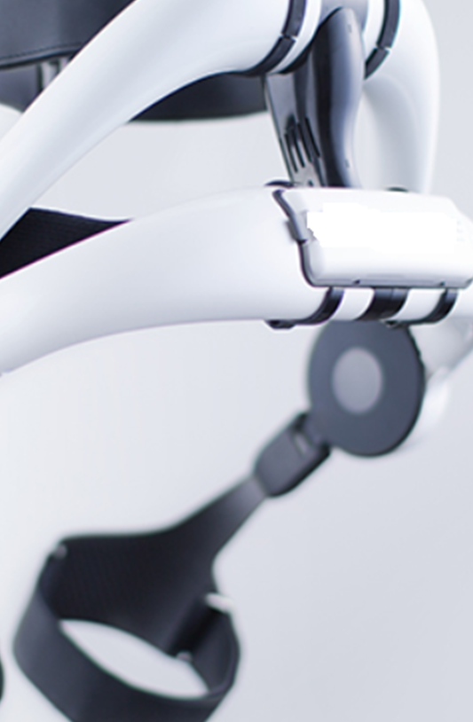
Our work to date
2020 ‘Cobot’ pathfinder revealed the technology had a role to play in supporting safe and efficient care delivery, particularly in the context of ‘single handed care’
Dedicated project team working collaboratively with providers including OTs who provide comprehensive assessments for equipment and moving and handling techniques
Initial focus was to work with targeted care at home services (both in house and through providers) with the aim of supporting and strengthening relationships with our care providers alongside embedding and enhanced and sustained care ethos.
Still early days but through enhancements identified, we have managed to create capacity of over 350 hours per week with our care at home providers

Slide 4
Enhanced and sustainable care model: How will we do things differently?
Key elements required for successful care delivery
Comprehensive training and development
Open to change
Care worker
Manual handling skills
Confidence & competencies
Ongoing risk assessment and management
Care delivery
Equipment
Technology
Service user
We are using cobot technology to enable more physical care to be delivered independently
Environment
Ongoing assessment of needs

Slide 5
How do you think we can embed an enhanced and sustained care ethos across the system in Hampshire?

